Slide 1

Project Two
Done By:
Shamim Munnawar Bhagat
General Assembly Singapore

Slide 2
About My Project
WEATHER BLOG
Page Header:
Climate change is REAL!
Inspiration behind my project:
Watching documentaries on changing weather patterns globally and witnessing them myself.
Changing rainfall patterns
Higher incidence of mosquito borne diseases
Self interest in weather forecasting
Aim
To reach out to people to post their own weather related stories and observations .

Slide 3
Blog Features
1.Single User blog
Only ONE user can post during one session
2. Users can sign up with their email
3.Users can log in with their email address and password
4.A dedicated central page where all articles posted by that user are rendered
5.An individual article page where users’ can edit and/or delete their post and netizens can leave their comments.
6.Dedicated pages for creation & submission of new articles and comments.
7.Dedicated pages for users to update their articles.

Slide 4
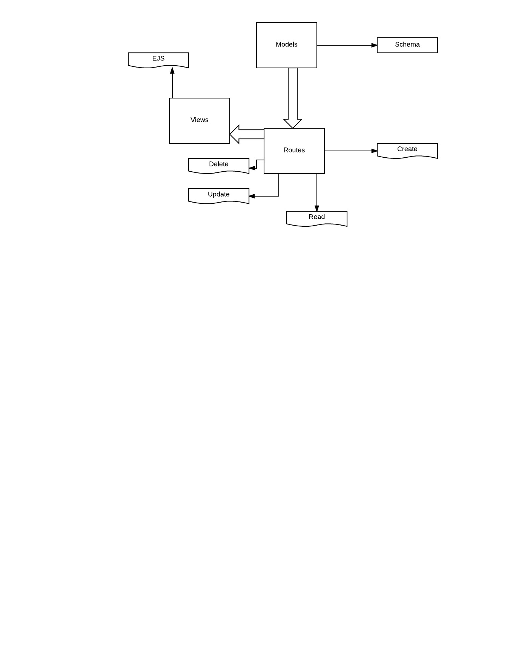
App Features
1.Built in Express.Js
2.NPM- Node Package Manager
Contains various packages needed to run an app built in express
3.MongoDB
This is where user details i.e passwords ,articles and comments are stored as objects
4.Uses Mongoose.Js to transfer objects to MongoDB
5.Hosted on Heroku

Slide 5
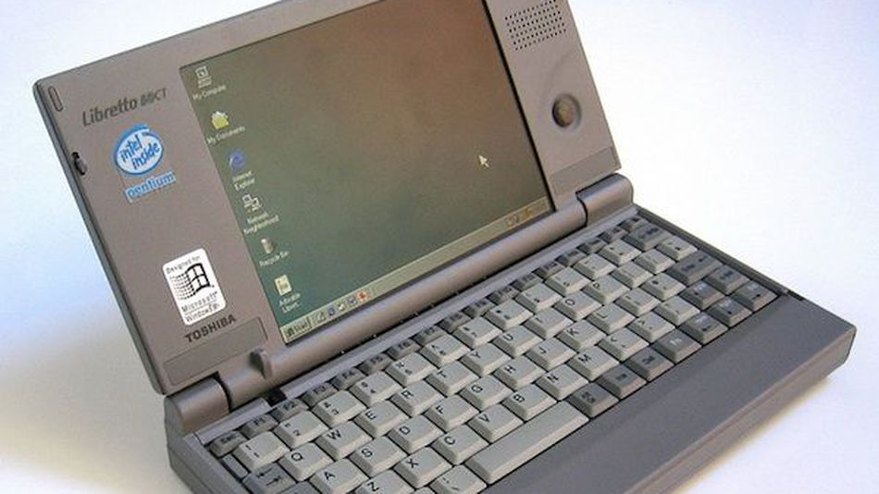
Code Planning
User signs up
If user has an existing account, he can log in via the login page
In both cases , he is redirected to the main page
2. User creates a post
routed to a form where he title’s and writes his post
User submits post. Post is stored on mongoDB as an object
User redirected to main page
User views post
User edits or deletes post
User comments on post
User deletes post
User logs out
Passerby netizens leave comments on users’ posts

Slide 6
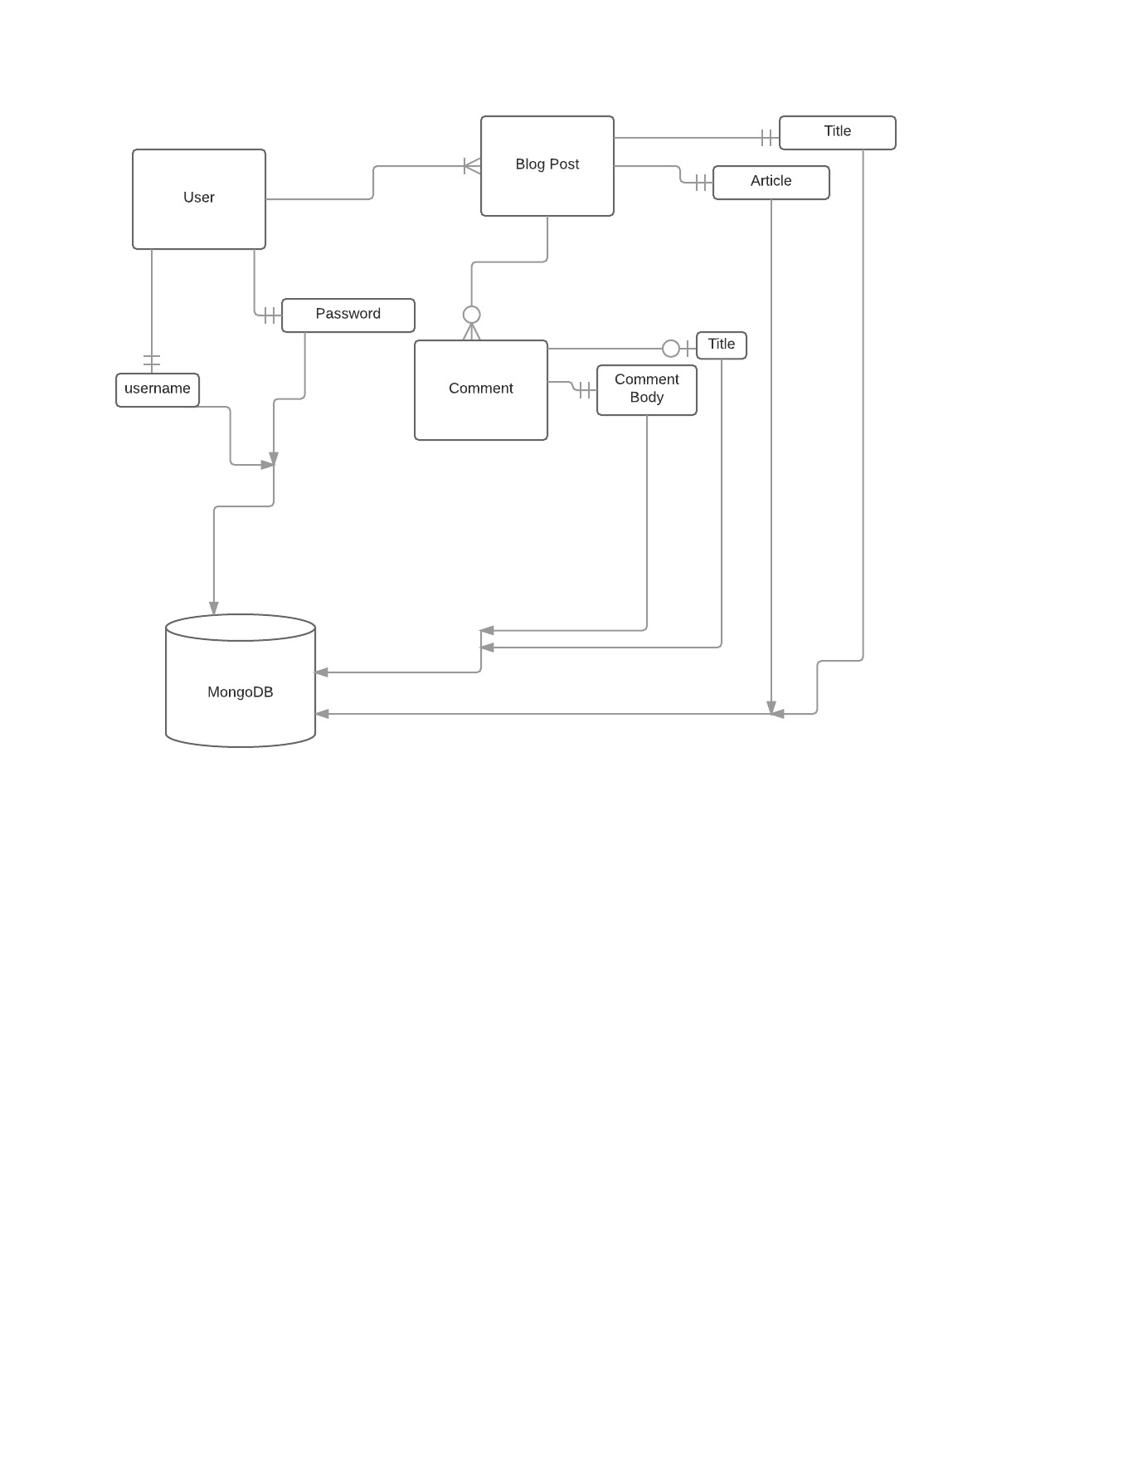
ERD

Slide 7
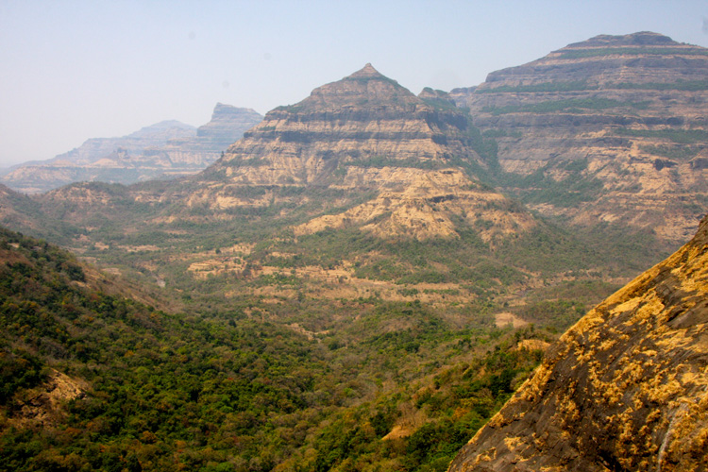
Difficulties Faced
Many bugs encountered
Built code first before testing functionality
Late Nights
Editing Comments
5. Ensuring good styling
6. Panic attacks

Slide 8
References && Credits
Gitbook
Mozilla Development Network
MongoDB
www.expressjs.com
www.mongoosejs.com
Stack Overflow
Mean Web Development Book
Mr Glen Tan, Mr Prima Aulia Gusta, Miss Tan K L
www.lucidchart.com
Heroku

Slide 9

THANK YOU
& HAVE A GREAT WEEKEND

